Slide 1

Presented by
Vikas Chandra

Slide 2
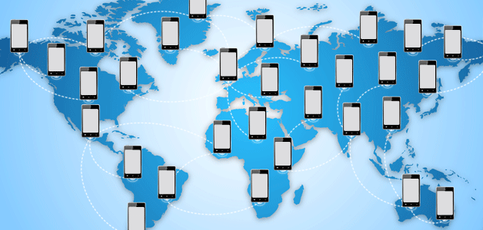

Slide 3
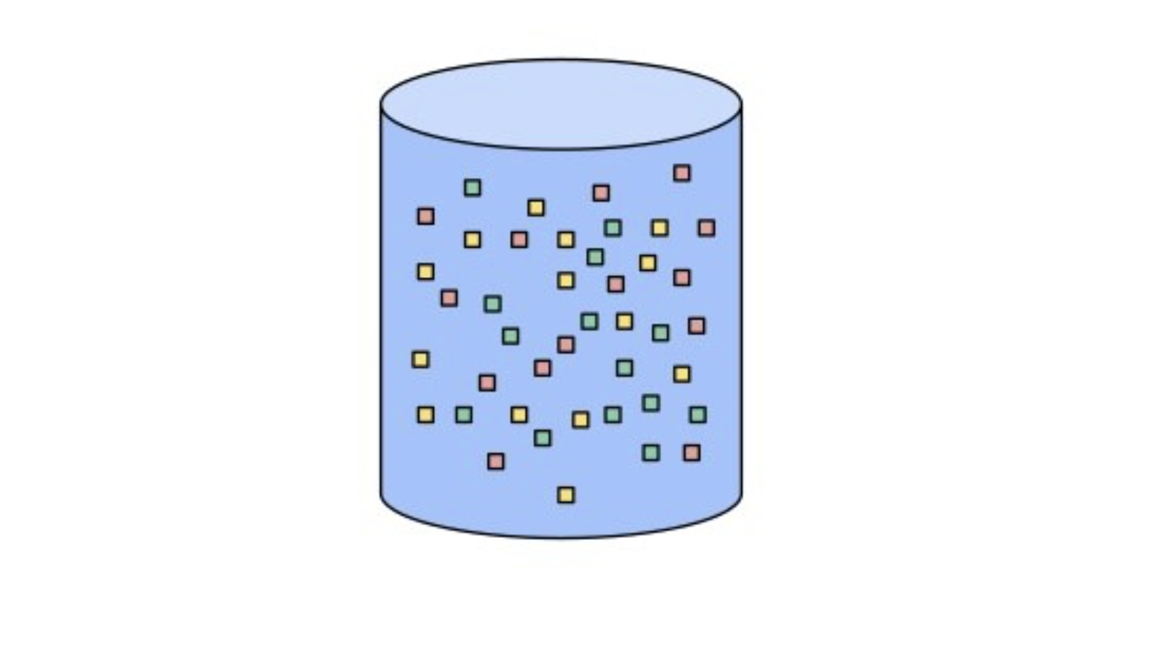
Data

Slide 4
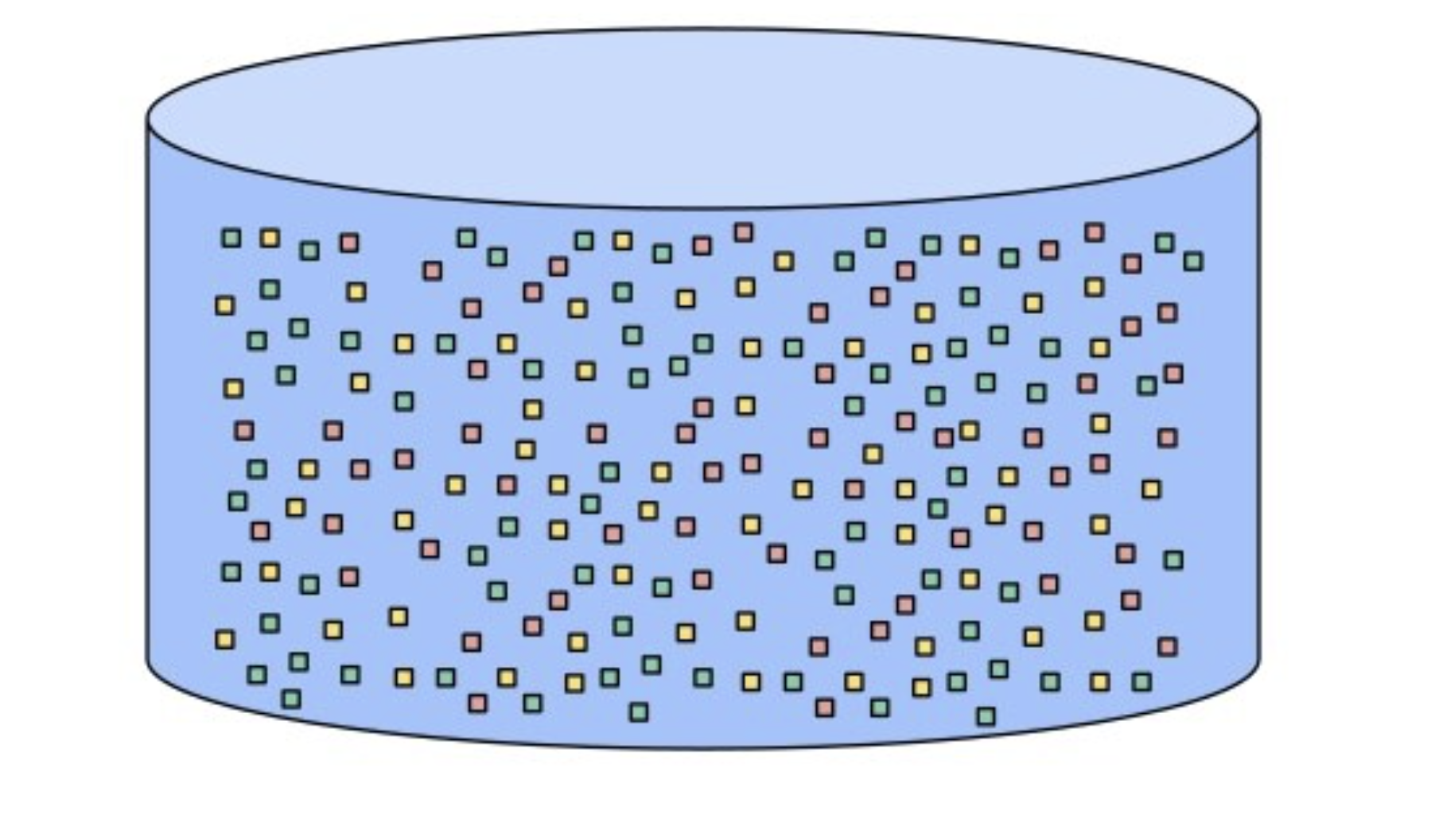
BIGData

Slide 5
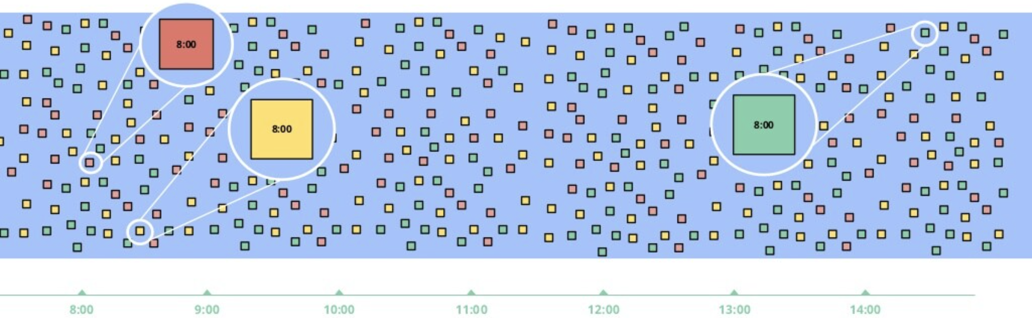
DELAYS

Slide 6
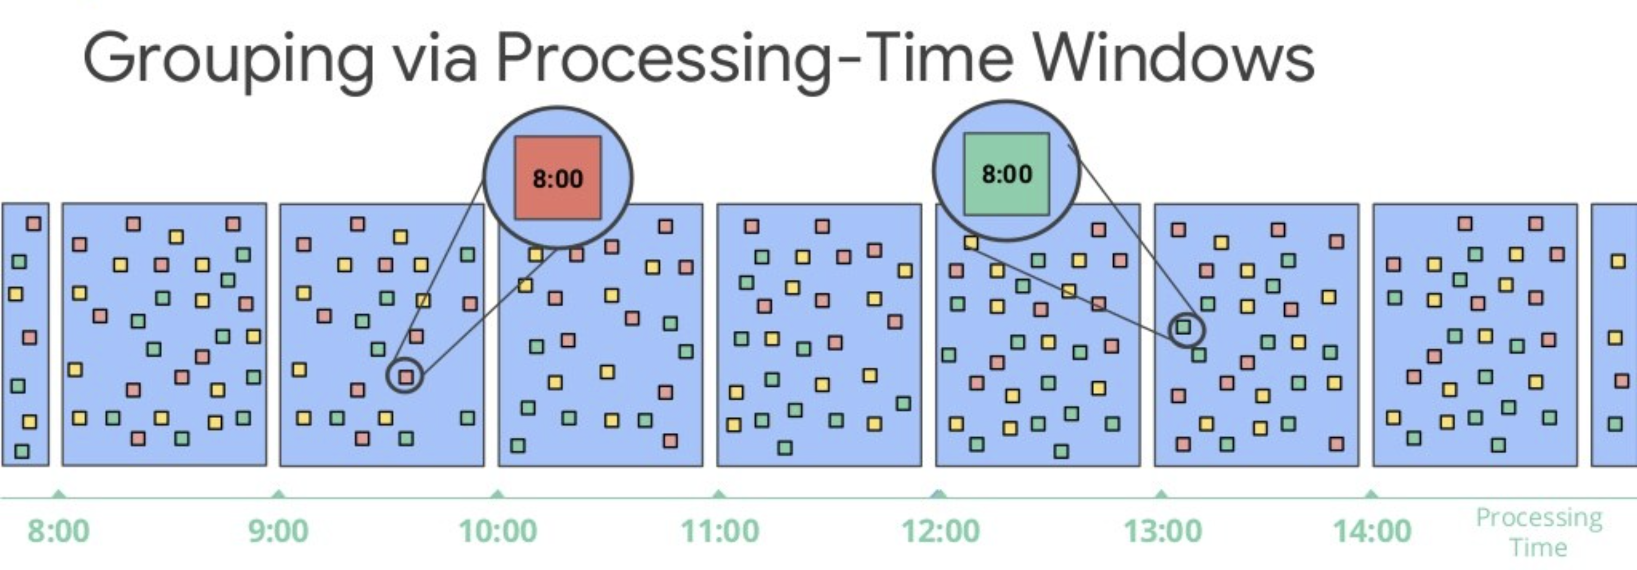

Slide 7
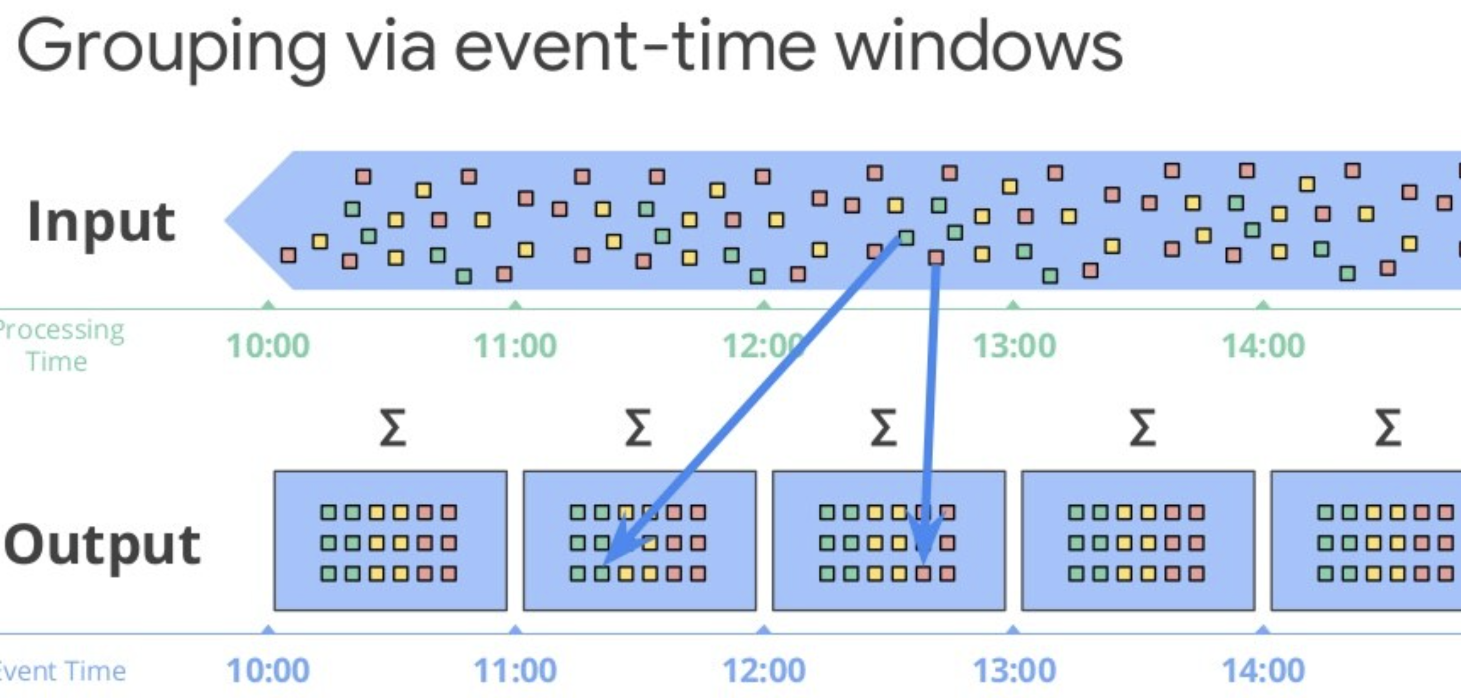

Slide 8
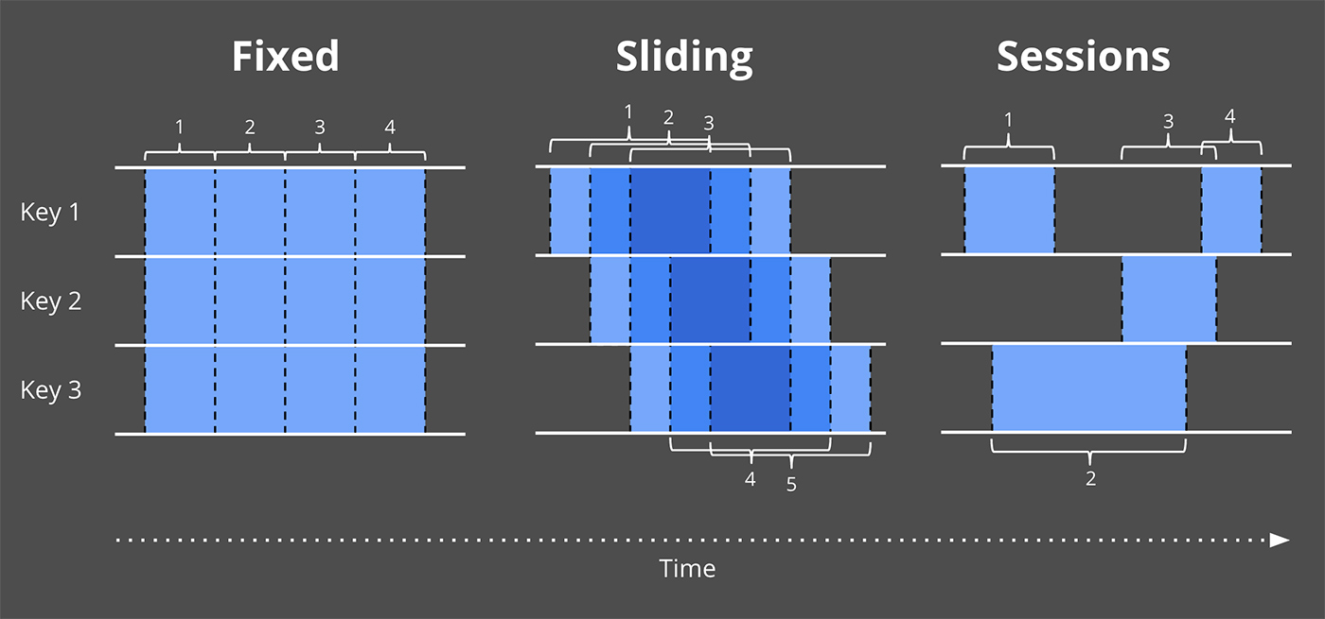

Slide 9
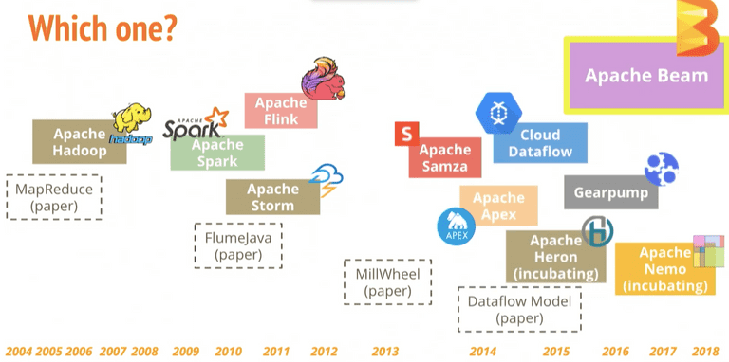

Slide 10
APACHE BATCH STREAM

Slide 11
Apache BEAM is Unified processing model for expressing efficient and portable data processing pipelines

Slide 12
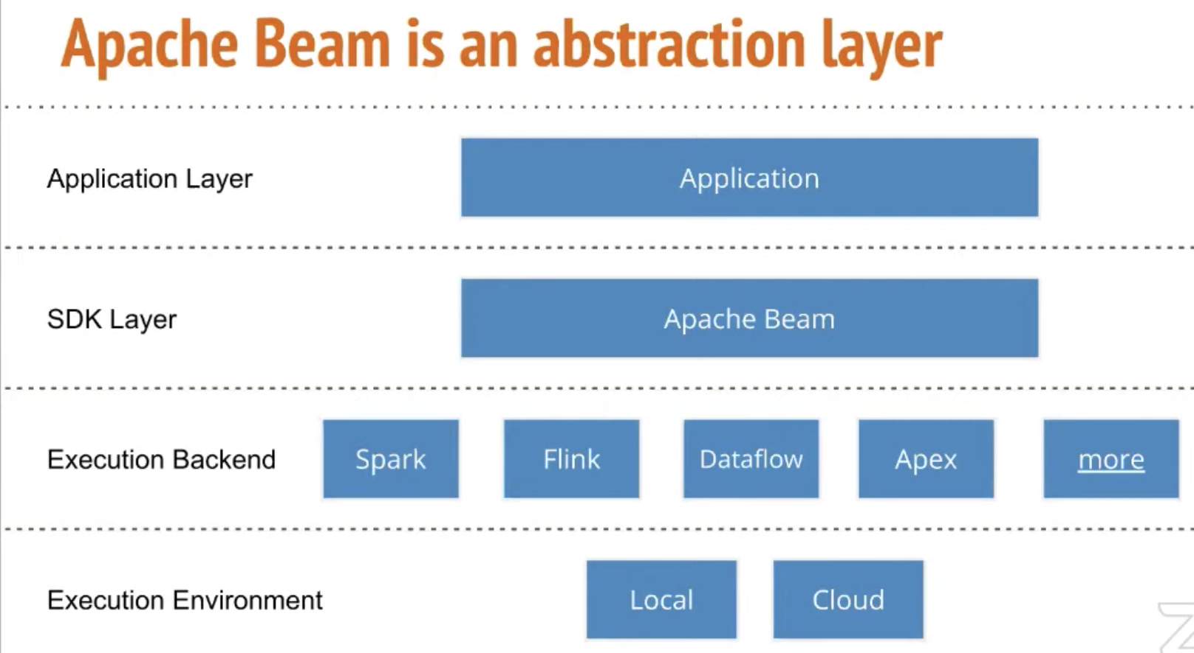

Slide 13






Pipeline
Input Data
Read
Input Data
Transform Data
Dump output Data
PCollection
PTransform

Slide 14
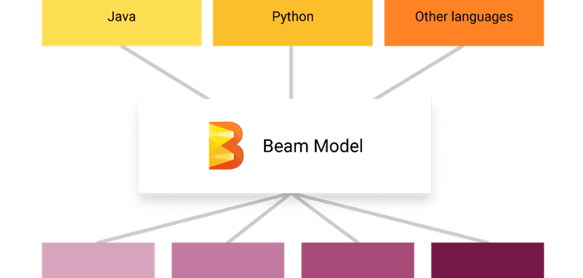

Slide 15
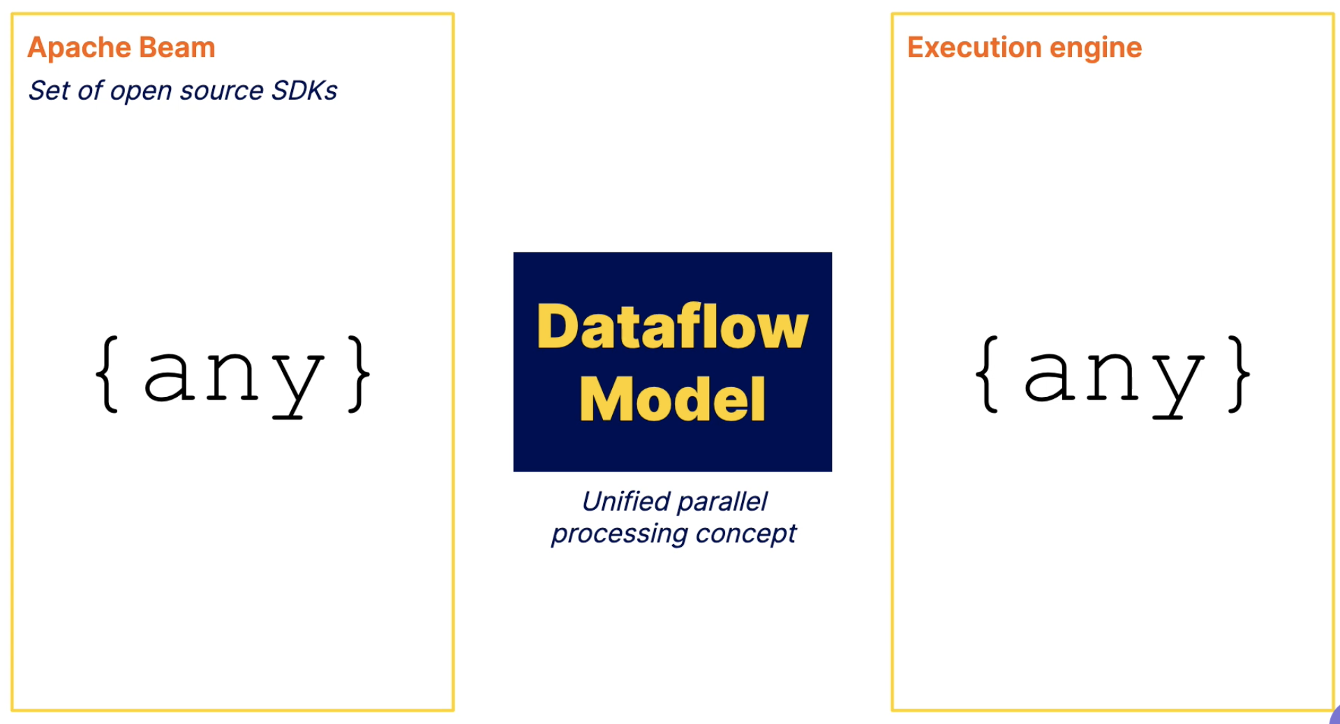

Slide 16
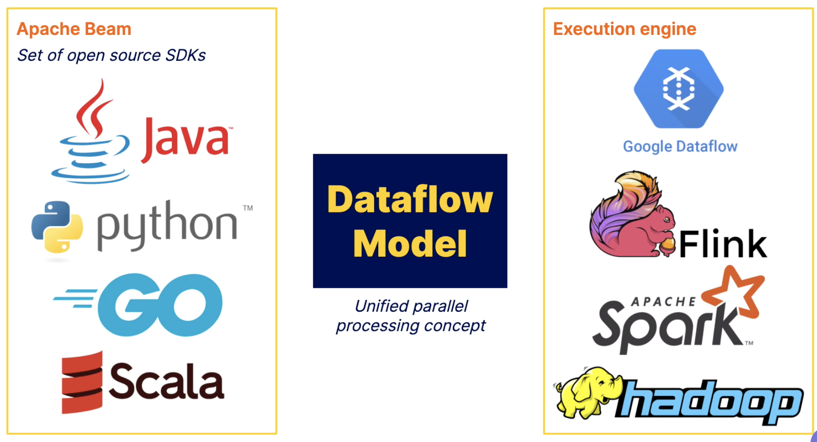

Slide 17


Slide 18
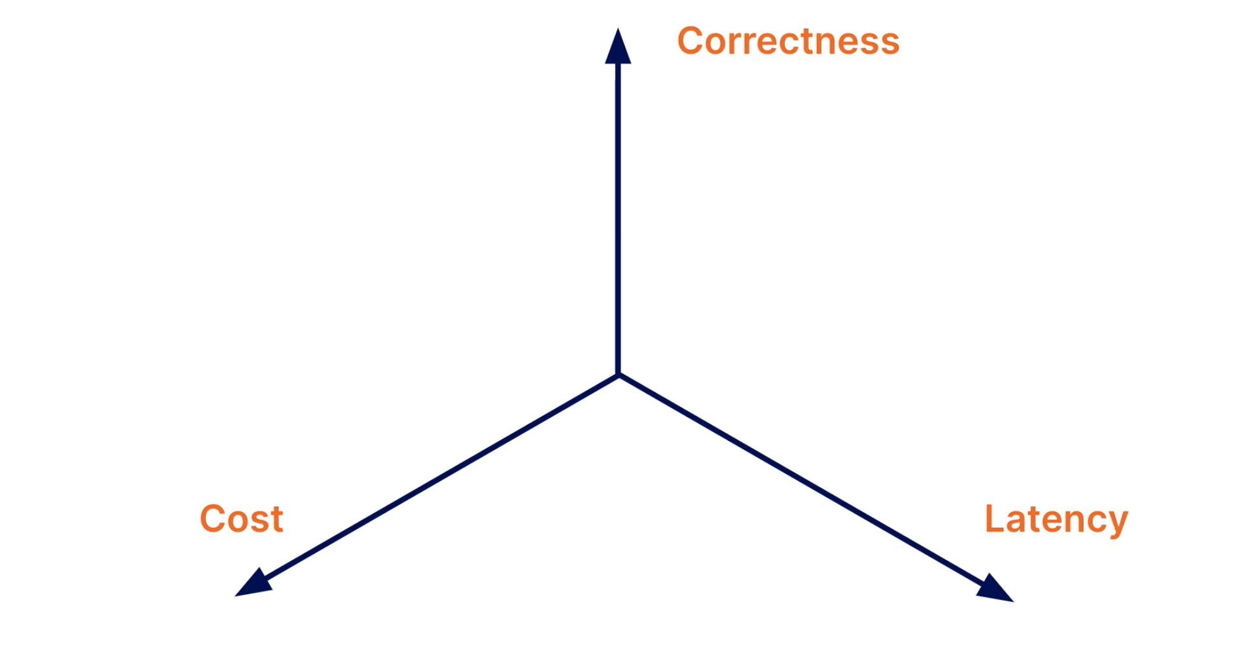

Slide 21
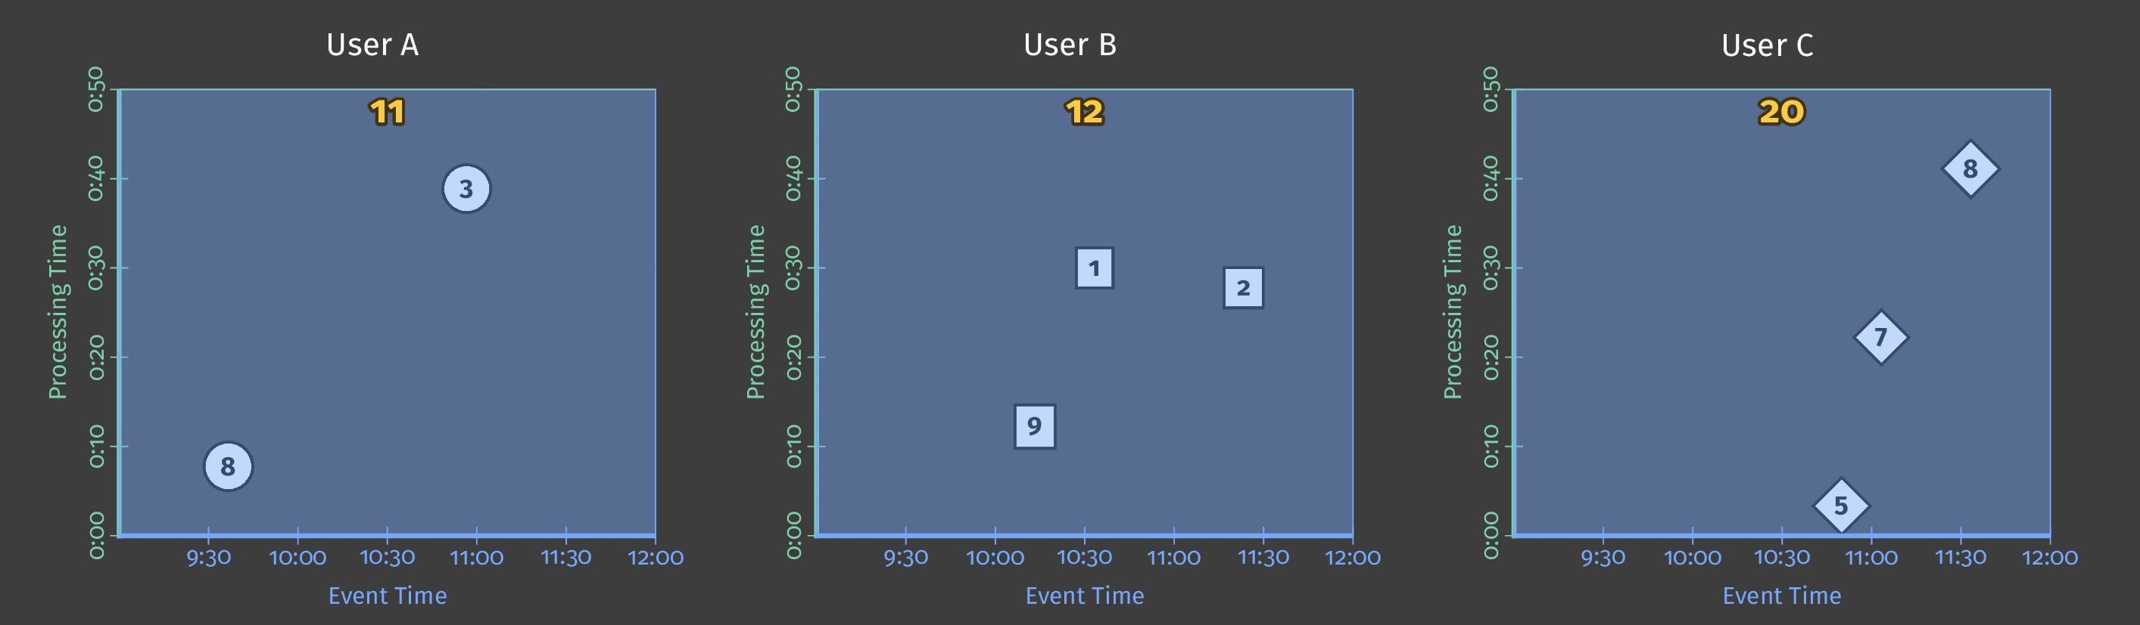
Score data for three users

Slide 22
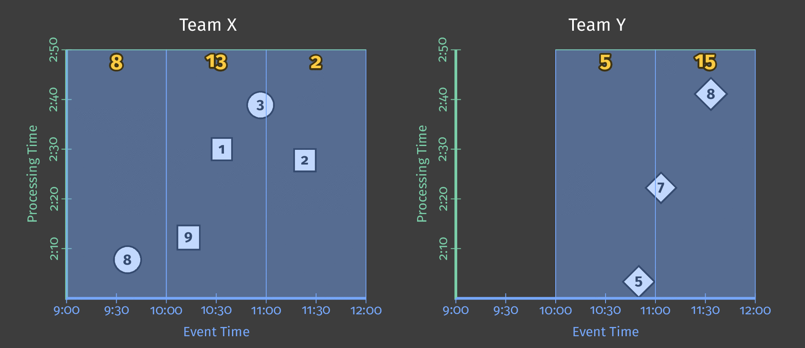
Fixed-Time Windowing

Slide 23
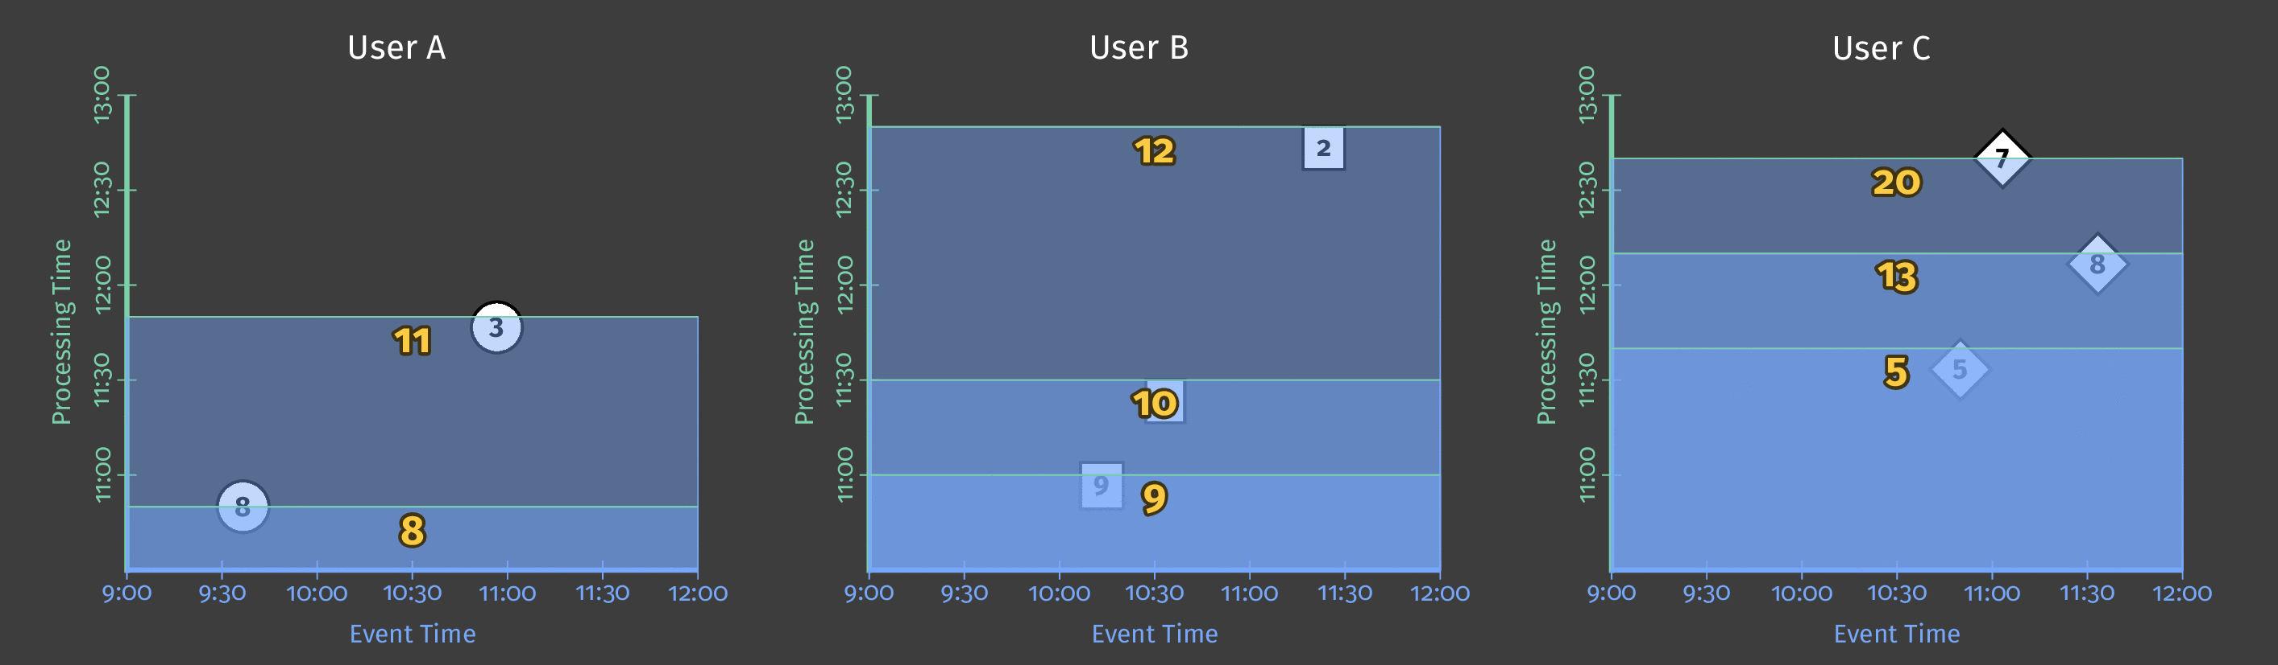
User Score based on Processing Time

Slide 24
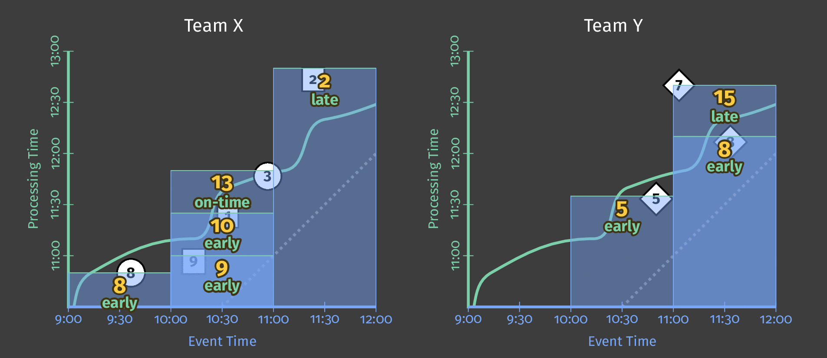
Team Score based on Event Time

Slide 25
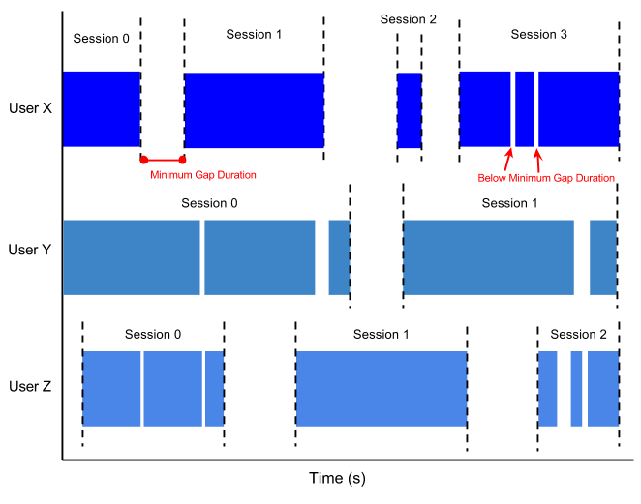
User sessions with a minimum gap duration

